Slide 1

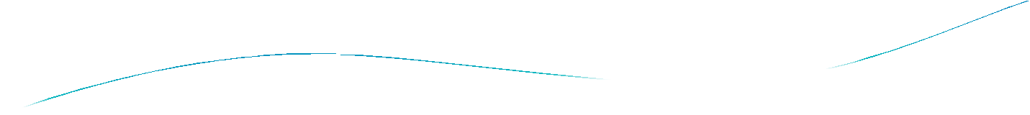



Section 6.4

Slide 2

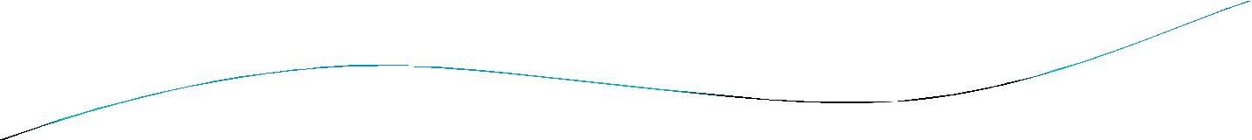
Section Summary
The Binomial Theorem
Pascal’s Identity and Triangle

Slide 3




Binomial Theorem
Binomial Theorem: Let x and y be variables, and n a nonnegative integer. Then:
Proof: We use combinatorial reasoning . The terms in the expansion of (x + y)^{n} are of the form x^{n−j}y^{j} for
j = 0,1,2,…,n. To form the term x^{n−j}y^{j}, it is necessary to choose n−j xs from the n sums. Therefore, the coefficient of x^{n−j}y^{j} is which equals .

Slide 4



Powers of Binomial Expressions
Definition: A binomial expression is the sum of two terms, such as x + y. (More generally, these terms can be products of constants and variables.)
We can use counting principles to find the coefficients in the expansion of (x +
y)^{n} where n is a positive integer.
To illustrate this idea, we first look at the process of expanding (x + y)³.
(x + y) (x + y) (x + y) expands into a sum of terms that are the product of a term
from each of the three sums.
Terms of the form x³, x²y, x y², y³ arise. The question is what are the coefficients?
To obtain x³ , an x must be chosen from each of the sums. There is only one way to do this. So, the coefficient of x³ is 1.
To obtain x²y, an x must be chosen from two of the sums and a y from the other.
There are ways to do this and so the coefficient of x²y is 3.
To obtain xy², an x must be chosen from of the sums and a y from the other two . There are ways to do this and so the coefficient of xy² is 3.
To obtain y³ , a y must be chosen from each of the sums. There is only one way to do this. So, the coefficient of y³ is 1.
We have used a counting argument to show that (x + y)³ = x³ + 3x²y + 3x y² + y³ .
Next we present the binomial theorem gives the coefficients of the terms in the expansion of (x + y)^{n} .

Slide 5

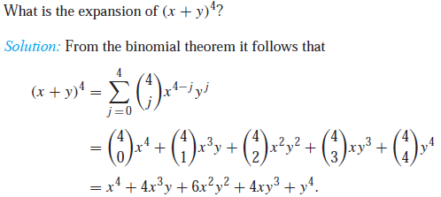
Using the Binomial Theorem
Example:

Slide 6
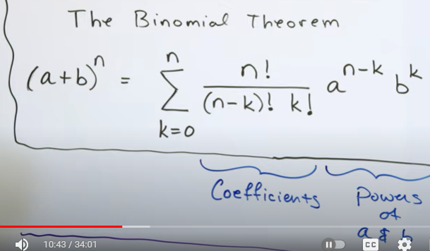

Slide 7

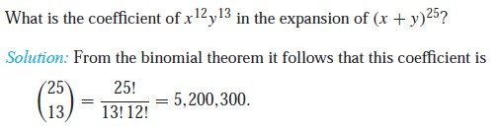
Using the Binomial Theorem

Slide 8

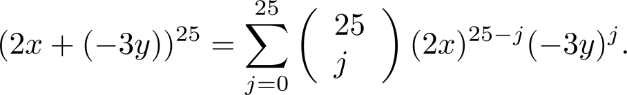
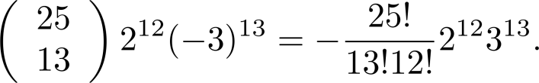
Using the Binomial Theorem
Example: What is the coefficient of x¹²y¹³ in the expansion of (2x − 3y)²⁵?
Solution: We view the expression as (2x +(−3y))²⁵. By the binomial theorem
Consequently, the coefficient of x¹²y¹³ in the expansion is obtained when j = 13.

Slide 9

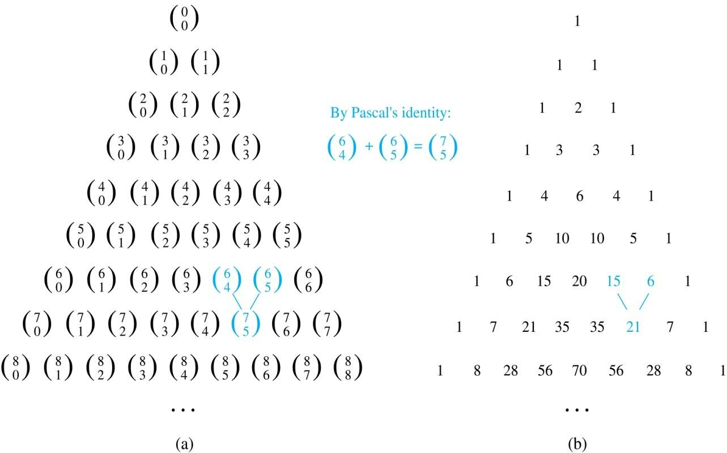

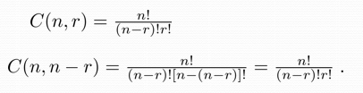
Pascal’s Triangle
The nth row in the triangle consists of the binomial coefficients , k = 0,1,….,n.
By Pascal’s identity, adding two adjacent bionomial coefficients results is the binomial coefficient in the next row between these two coefficients.

Slide 10

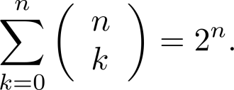
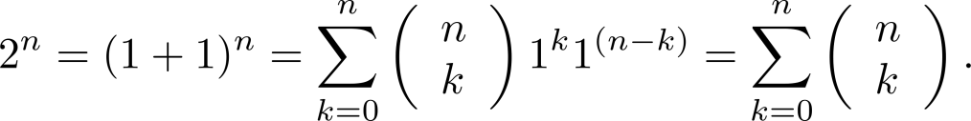




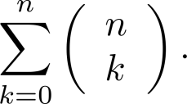
A Useful Identity
Corollary 1: With n ≥0,
Proof (using binomial theorem): With x = 1 and y = 1, from the
binomial theorem we see that:
Proof (combinatorial): Consider the subsets of a set with n elements. There are subsets with zero elements, with one element, with two elements, …, and with n elements.
Therefore the total is
Since, we know that a set with n elements has 2^{n} subsets, we conclude:

Slide 11
Pascal’s Triangle
The nth row in the triangle consists of the binomial coefficients , k = 0,1,….,n.
By Pascal’s identity, adding two adjacent bionomial coefficients results is the binomial coefficient in the next row between these two coefficients.

Slide 12

Chapter 10

Slide 13

Chapter Summary
Graphs and Graph Models
Graph Terminology and Special Types of Graphs
Representing Graphs and Graph Isomorphism
Connectivity
Euler and Hamiltonian Graphs
Shortest-Path Problems
Planar Graphs
Graph Coloring

Slide 14
Section 10.1

Slide 15

Section Summary
Introduction to Graphs
Graph Taxonomy
Graph Models

Slide 16



Graphs
Definition: A graph G = (V, E) consists of a nonempty set V of vertices (or nodes) and a set E of edges. Each edge has either one or two vertices associated with it, called its endpoints. An edge is said to connect its endpoints.
a
b
Example:
This is a graph with four vertices and five edges.
Remarks:
d c
The graphs we study here are unrelated to graphs of functions studied in Chapter 2.
We have a lot of freedom when we draw a picture of a graph. All that matters is the connections made by the edges, not the particular geometry depicted. For example, the lengths of edges, whether edges cross, how vertices are depicted, and so on, do not matter
A graph with an infinite vertex set is called an infinite graph. A graph with a finite vertex set is called a finite graph. We (following the text) restrict our attention to finite graphs.

Slide 17




Some Terminology
In a simple graph each edge connects two different vertices and no two edges connect the same pair of vertices.
Multigraphs may have multiple edges connecting the same two vertices. When m different edges connect the vertices u and v, we say that {u,v} is an edge of multiplicity m.
An edge that connects a vertex to itself is called a loop.
A pseudograph may include loops, as well as multiple edges connecting the same pair of vertices.
Example:
This pseudograph has both multiple edges and a loop.
a
b
Remark: There is no standard terminology for graph theory. So, it is crucial that you understand the terminology being used whenever you read material about graphs.
c

Slide 18

Directed Graphs
Definition: An directed graph (or digraph) G = (V, E) consists of a nonempty set V of vertices (or nodes) and a set E of directed edges (or arcs). Each edge is associated with an ordered pair of vertices. The directed edge associated with the ordered pair (u,v) is said to start at u and end at v.
Remark:
Graphs where the end points of an edge are not ordered are said to be undirected graphs.

Slide 19

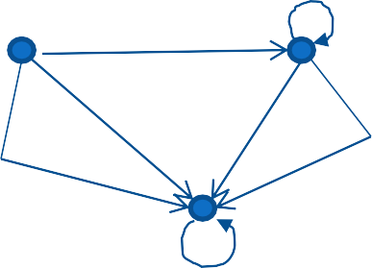
Some Terminology (continued)
A simple directed graph has no loops and no multiple edges.
Example:
This is a directed graph with three vertices and four edges.
a
b
c
A directed multigraph may have multiple directed edges. When there are m directed edges from the vertex u to the vertex v, we say that (u,v) is an edge of multiplicity m.
Example:
In this directed multigraph the multiplicity of (a,b) is 1 and the multiplicity of (b,c) is 2.
a
b
c

Slide 20

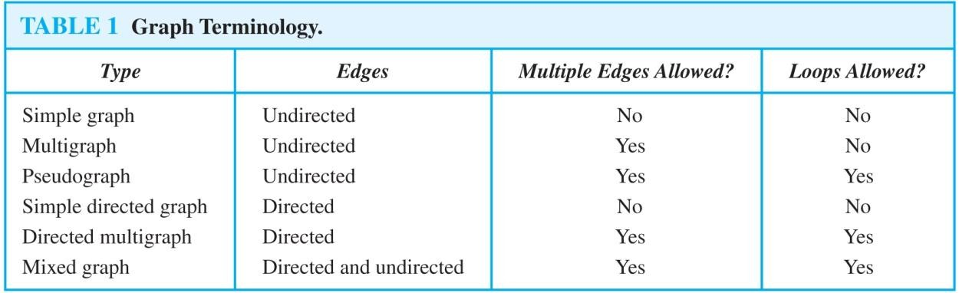
Graph Terminology: Summary
To understand the structure of a graph and to build a graph model, we ask these questions:
Are the edges of the graph undirected or directed (or both)?
If the edges are undirected, are multiple edges present that connect the same pair of vertices? If the edges are directed, are multiple directed edges present?
Are loops present?

Slide 21

Other Applications of Graphs
We will illustrate how graph theory can be used in models of:
Social networks
Communications networks
Information networks
Software design
Transportation networks
Biological networks
It’s a challenge to find a subject to which graph theory has not yet been applied. Can you find an area without applications of graph theory?

Slide 22

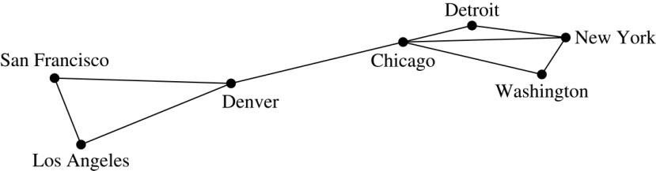
Graph Models: Computer Networks
When we build a graph model, we use the appropriate type of graph to capture
the important features of the application.
We illustrate this process using graph models of different types of computer networks. In all these graph models, the vertices represent data centers and the edges represent communication links.
To model a computer network where we are only concerned whether two data centers are connected by a communications link, we use a simple graph. This is the appropriate type of graph when we only care whether two data centers are directly linked (and not how many links there may be) and all communications links work in both directions.

Slide 23

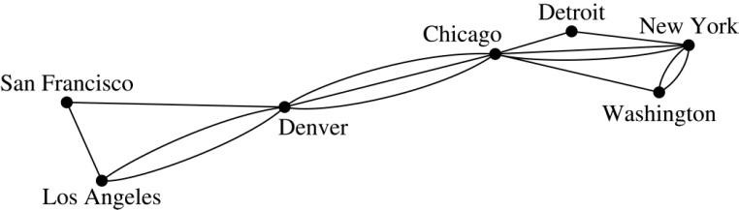
Graph Models:
Computer Networks (continued)
To model a computer network where we care about the number of links between data centers, we use a multigraph.

Slide 24

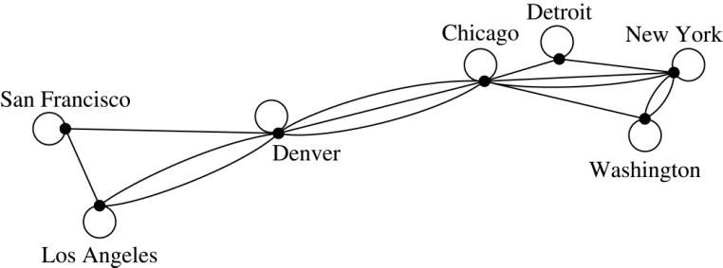
Graph Models: Computer Networks
To model a computer network with diagnostic links at data centers, we use a pseudograph, as loops are needed.

Slide 25

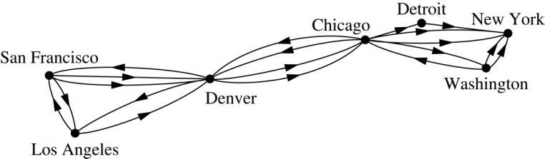
Graph Models: Computer Networks
To model a network with multiple one-way links, we use a directed multigraph. Note that we could use a directed graph without multiple edges if we only care whether there is at least one link from a data center to another data center.

Slide 26

Graph Models: Social Networks
Graphs can be used to model social structures based on different kinds of relationships between people or groups.
In a social network, vertices represent individuals or organizations and edges represent relationships between them.
Useful graph models of social networks include:
friendship graphs - undirected graphs where two people are connected if they are friends (in the real world, on Facebook, or in a particular virtual world, and so on.)
collaboration graphs - undirected graphs where two
people are connected if they collaborate in a specific way
influence graphs - directed graphs where there is an edge from one person to another if the first person can
influence the second person..

Slide 27

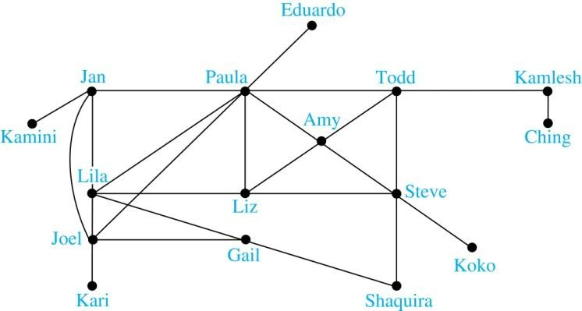
Graph Models: Social Networks
Example: A friendship graph where two people are connected
if they are Facebook friends.

Slide 28

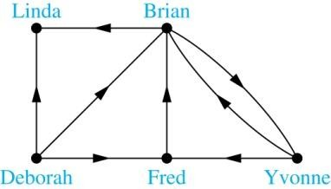
Graph Models: Social Networks
Example: An influence graph

Slide 29

Applications to Information Networks
Graphs can be used to model different types of networks that link different types of information.
In a web graph, web pages are represented by vertices and links are represented by directed edges.
A web graph models the web at a particular time.
We will explain how the web graph is used by search engines in Section 11.4.
In a citation network:
Research papers in a particular discipline are represented by vertices.
When a paper cites a second paper as a reference, there is an edge from the vertex representing this paper to the vertex representing the second paper.

Slide 30

Transportation Graphs
Graph models are extensively used in the study of transportation networks.
Airline networks can be modeled using directed multigraphs where
airports are represented by vertices
each flight is represented by a directed edge from the vertex representing the departure airport to the vertex representing the destination airport
Road networks can be modeled using graphs where
vertices represent intersections and edges represent roads.
undirected edges represent two-way roads and directed edges represent one-way roads.

Slide 31

Software Design Applications
Graph models are extensively used in software design. We will introduce two such models here; one representing the dependency between the modules of a software application and the other representing restrictions in the execution of statements in computer programs.
When a top-down approach is used to design software, the system is divided into modules, each performing a specific task.
We use a module dependency graph to represent the dependency between these modules. These dependencies need to be understood before coding can be done.

Slide 32

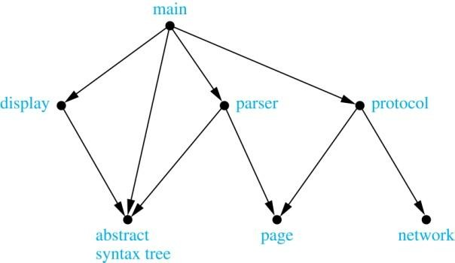
Software Design Applications
In a module dependency graph vertices represent software modules and there is an edge from one module to another if the second module depends on the first.
Example: The dependencies between the seven modules in the
design of a web browser are represented by this module dependency
graph.

Slide 33

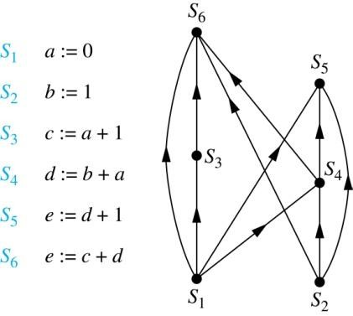
Software Design Applications
We can use a directed graph called a precedence graph to represent which statements must have already been executed before we execute each statement.
Vertices represent statements in a computer program
There is a directed edge from a vertex to a second vertex if the second vertex cannot be executed before the first
Example: This precedence graph shows which statements must already have been executed before we can execute each of the six statements in the program.

Slide 34

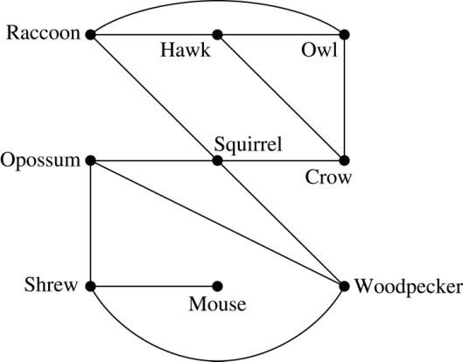
Biological Applications
Graph models are used extensively in many areas of the biological science. We will describe two such models, one to ecology and the other to molecular biology.
Niche overlap graphs model competition between species in an ecosystem
Vertices represent species and an edge connects two vertices when they represent
species who compete for food resources.
Example: This is the niche overlap graph for a forest ecosystem with nine species.

Slide 35

Biological Applications
We can model the interaction of proteins in a cell using a
protein interaction network.
In a protein interaction graph, vertices represent proteins and vertices are connected by an edge if the proteins they represent interact.
Protein interaction graphs can be huge and can contain more than 100,000 vertices, each representing a different protein, and more than 1,000,000 edges, each representing an interaction between proteins
Protein interaction graphs are often split into smaller graphs, called modules, which represent the interactions between proteins involved in a particular function.

Slide 36

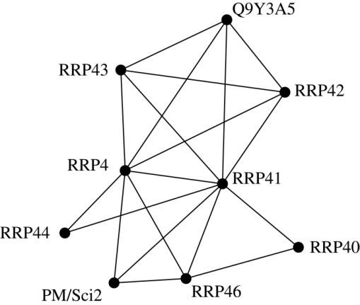
Biological Applications
Example: This is a module of the protein interaction graph of proteins that degrade RNA in a human cell.

